Slide 1
Introduction
CSE11
Mobile App Design and Development

Slide 2
Overview
Mobile (Phones and Gadgets)
Handheld devices
Mobile Applications
Software made for use in mobile devices
Application Design
Process of conceptualizing an applications’ features, architecture,
Application Development
Process of creating the code for an application
Notes:
Discussion Points:
1. Mobile - Kinds and examples of mobile devices
2. Mobile Applications – Categories and examples of mobile applications
Purposes of each the categories
Benefits of using mobile applications as opposed to a web or desktop application
3. Design Vs Development, difference and how it overlaps

Slide 3
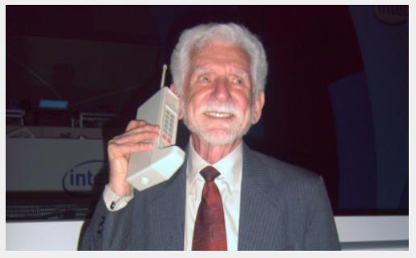
History
First public cellular phone call was made in 1973 by Martin Cooper of Motorola
It took 10 years before the first commercially available mobile device was released

Slide 4
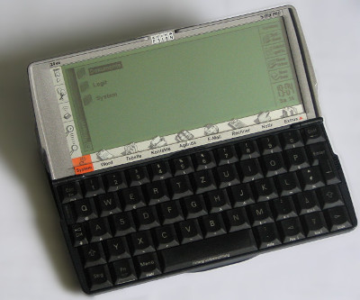
History
First recognizable apps were released in the early 90s by a company called Psion
Most of the apps are PDAs (Personal Digital Assistants)

Slide 5
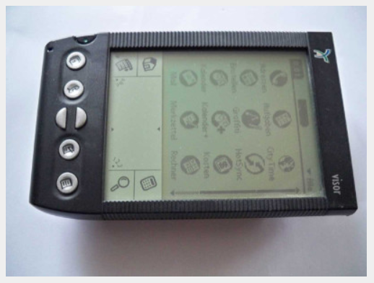
History
A company called Palm rivalled Psion with a cheaper device called Palm Pilot
It was commercially successful and allowed the company to develop Palm OS in 1996, which had a touchscreen capability
Notes:
Discussion Point:
Other company’s that developed their own mobile devices with mobile applications are Nokia and Ericsson

Slide 6
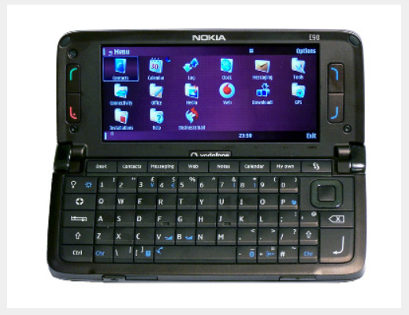
History
In the 2000s, Nokia phones running on Symbian dominated the market reaching up to 37.6% market share in 2010

Slide 7
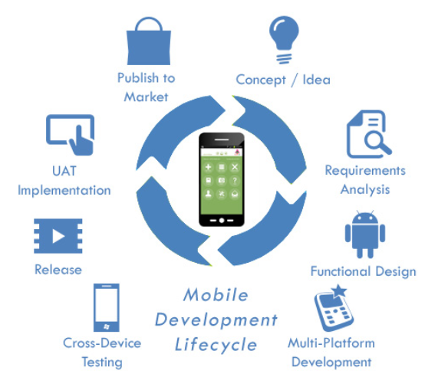
Mobile Development Lifecycle
Source: ALTEC iSys
http://www.altecisys.com/india/mobile-app-development.aspx
Notes:
Discussion Point
Mobile Banking App – Go through the steps of the development lifecycle

Slide 8
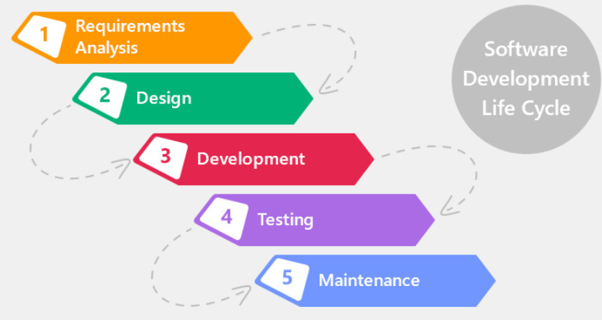
SDLC - Waterfall Model

Slide 9
SDLC - Waterfall Model
Requirements Analysis
Involves understanding what kind of software is to be created and what features will it have
Outputs: Product Requirements Document, Use Cases
Design
Involves the identification of hardware and system requirements and also helps in defining overall system architecture.
Outputs: Software Architecture, Class Diagrams, Database Models

Slide 10
SDLC - Waterfall Model
Development
Construction of the software. It involves setting up the development environment and actual creation of the program code
Outputs: Prototypes, Software (pre-deployment version)
Testing
Involves verification of the system requirements and detection of bugs and the code correction for such findings.
Outputs: Defects and Fixes, Software

Slide 11
SDLC - Waterfall Model
Deployment and Maintenance
Go Live! and post-deployment support.
Tasks: Installation, Migration, Support and Maintenance

Slide 12
Overview – Mobile OS
Mobile OS
Operating Systems used in mobile devices

Slide 13
Overview – Mobile OS
What Mobile OS are represented by the following logos?

Slide 14

Overview – Mobile OS

Slide 15
Overview – Mobile OS
BlackBerry

Slide 16

Overview – Mobile OS

Slide 17
Overview – Mobile OS
Android

Slide 18

Overview – Mobile OS

Slide 19
Overview – Mobile OS
Windows

Slide 20

Overview – Mobile OS

Slide 21
Overview – Mobile OS
iOS

Slide 22
Android (Brief Facts)
Android started as a proposed advanced operating system for digital cameras
It was unveiled in 2007 by the Open Handset Alliance
Currently under the flagship of Google
Android has a dominant share of the mobile market of 74.85% as of April 2019
Android is supported by several smartphone manufactures such as Sony, Samsung, and HTC
Android applications are coded in Java, XML

Slide 23
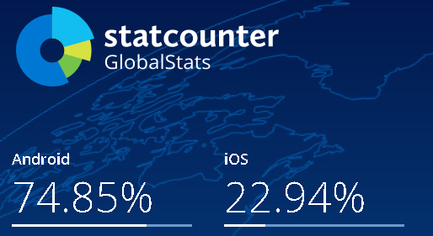
Market Share Comparison
Notes:
As of 2015

Slide 24
Java Review
Object-Oriented Programming Terms
Object
Class
Instance
Attributes
Methods
Inheritance
Polymorphism (Overloading and Overriding)
Variables
Data Types/Primitive Types
String Functions

Slide 25
Java Review
Logical Flows
If - Else If - Else
Switch – Case
Loops
For Loop
While Loop
Do-While Loop
Try-Catch

Slide 26
Group Activity
3 members per group
Think of an Android Application you want to develop.
Should be feasible to be developed until the end of term
The application must have a need for the use of a Database (whether online or in-device)
Submit a word file in this email address:
jrsimpadua@uc-bcf.edu.ph

Slide 27
Group Activity (Output)
Application Name
Description of the application (think of the description you see in Google Play). 8-10 sentences
3 Unique Features of the Application, explain each item in 3-5 sentences.
Any of these:
Initial Logo
Initial Home screen
Initial Main screen

Slide 28
Sources
A History of Mobile Application Development; https://manifesto.co.uk/history-mobile-application-development/

